Slide 1
http://blog.ted.com/steven_johnson_1/
Cholera outbreak in London 1854

Slide 2

Disease Detectives

Slide 3
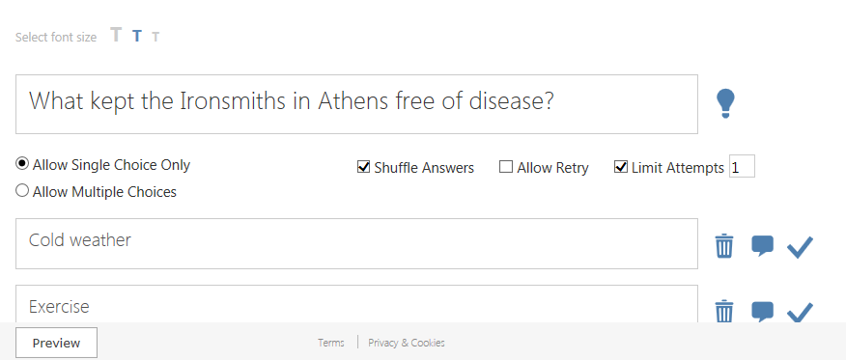
Review Video

Slide 4

Mission Possible:
The Case of the
Picnic Poisoning

Slide 5
Career Pathway:
Health Informatics Occupations
These occupations collect, manage, organize, and analyze information in the healthcare field.
These occupations require computer technology skills and knowledge of healthcare and office software.
Notes:
The health informatics pathway has careers that range from entry level to professional status. You may take classes in high school like medical terminology, medical anatomy and physiology, and when you are a senior you may take a medical assistance class and graduate ready to work in a doctor’s office. Health informatics includes any of the careers that require research and analysis, lab technician and epidemiologist are just two examples. Ask the class if they can think of any other careers in healthcare that do these kinds of duties?

Slide 6
Activity 1 Worksheet: collect data on the 4 picnic contributors
On the next 4 slides you need to collect data (details) describing the people who contributed to the picnic.
Match the people to the pictures that represent their part in this scenario by writing the LETTER of the person in the square to the left of the picture.

Slide 7
Molly
She is a local housewife who runs a day care center for 9 children approximately 1-8 years old.
She was asked to cook 15 hams.
The day of the banquet she and 3 of her older day care children spent most of the day preparing the hams in her kitchen.
She also has a soft spot for birds and cats; you are told she has 4 birds and 12 cats.

Slide 8
Mike
He runs the town’s meat packing plant.
He and his wife donated 150 pounds of beef and pork and Mike is cooking it over several open pit barbeques.
Several kids, ages 5-9, are playing near some of the uncovered meat.
You also note several flies camping on the beef, and a no-pest strip hanging close by.

Slide 9
Abram
He is the manager of the Roto Rooter Fertilizer outlet in the state’s Capitol, about 290 miles away.
He has been ill recently, and only helped mix the salad after nobody else would volunteer to do it.
Symptoms of his recent illness include double vision, diarrhea, high fever and skin lesions.
He feels fine now.

Slide 10
John
He is a hard-working local dairy farmer who has been asked to bring 200 gallons of red fruit punch.
Lacking anything else to bring the punch in, he uses several of his milk cans.
The milk cans have recently been repaired after several years of use.

Slide 11
The Case of the Potluck Poisoning . . .
It could happen anywhere . . .
On the evening of September 23, at approximately 8:30 p.m., your phone rings.
A nurse from your local hospital frantically tells you that she has 95 patients who are, as she describes it, “lying all over the place.”
They are vomiting, they have diarrhea and some are in such pain that they won’t even move from the hallways of the hospital or the front lawn of the community center.
Notes:
There is not a specific location to write down the details to the case but students may want to jot them down at the bottom of one of the worksheets if they want to be the first one to figure out the mystery.

Slide 12
Data review:
There was a community potluck dinner, which was attended by some 350 people.
The dinner began at 8:00 p.m.
The first sick patients began arriving at the hospital around 8:25 p.m.
It is time to explore 2 occupations to help you solve the case...

Slide 13

Role switch:
Hospital admittance
The admitting clerk of the hospital job duties include: obtaining personal and medical insurance information from all patients.
Family members begin to arrive and you get information from them.
Notes:
Have students switch roles from the epidemiologist to the admittance clerk. Explain that the “face” or first person that a patient comes in contact with is the admitting clerk in a hospital and usually a medical assistant or medical office administrative assistant in a clinic. Have a discussion about customer service and the ways in which an admitting clerk needs to be treating people who are in pain, or sick. This role play is a practice of empathy. You may want discuss what empathy means—putting yourself in someone else’s situation—it is not sympathy. Sympathy is feeling sorry or bad for someone.

Slide 14
Activity 2: Patient Record
Get in pairs.
You will be the patient and answer the admittance clerk’s questions and then switch.
This is an exercise in empathy—how would it feel if you were the patient? How would you want to be treated?
You should make up your information about your age,
if you are married, phone number, etc.
Finish this activity before going on to the next slide.
Notes:
You may want to model the role play for your class before you let them act anything out in partners. I like to show students that you cannot control how a patient may act due to illness or pain but a healthcare professional must treat them with dignity and respect no matter what. Have students fill out their patient record and then take it to the “admittance clerk,” the clerk will then verify and get basic information to prep the doctor for the visit. They may want to ask them about their symptoms and when they started. Partners will then switch roles. Have a discussion about how it felt to be in the position of each role. Make sure to specify you want to discuss how it felt to play the role not the symptoms that the patients were sharing (the kids love to give crazy and gross details about what the patient was doing or saying).

Slide 15
Back at the scene
In the meantime, 3 environmental health specialists are sent to the picnic to collect food samples, which are transported to the public health laboratory at the hospital.
The environmental specialists collect the containers the food and drinks were served in.
By early the next morning, several patients are ready to be interviewed.
The epidemiologist interviews people who brought the food and drink.

Slide 16
Activity 3 Epidemiologist Chart
As you enter “1” for what the 5 people ate, the totals at the bottom of the chart are filled in.
Calculate the percent of people who got sick based on what they ingested.
Finish this activity before going on to the next slide.
Notes:
Have students read the information provided about patients and mark the details in the chart. After they have filled in the chart ask students to total the numbers at the bottom and figure out the percentage of people that got sick from each food or drink element. (You may have to have a mini lesson on how to calculate percentages.) After they have figured out the percentages the class should be able to identify that the fruit punch is what made the people sick.

Slide 17
There are many reasons why people get sick.
Viruses and bacteria may cause infections like strep throat and influenza (flu).
Some bacteria and viruses can live in food causing food-borne illnesses like salmonella and hepatitis A.
Exposure to excessive amounts of chemicals or chemical elements (also called minerals) can cause illness like heavy metal poisoning from lead or cadmium.

Slide 18
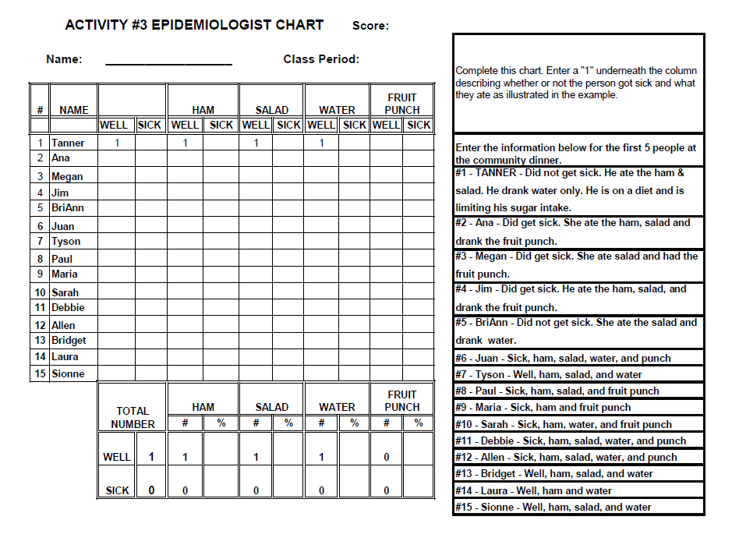

Slide 19
Activity 4: Classify Illnesses
Record the cause of each illness.
Record the time it takes to get sick.
Record what happens to the patient.
This information will help you solve the case.

Slide 20
Influenza (Flu)
Cause of the illness: this is an extremely contagious infection caused by a virus.
It attacks the nose, throat, and lungs.
Time for symptoms to occur: is short and the symptoms come on quickly.
Symptoms are: fever, headache, fatigue, dry cough, sore throat, congested nose, and body aches.
Most people will recover in one to two weeks, but a few people will progress to pneumonia and other complications including death. An average of
35,000 American’s die annually from influenza.

Slide 21
Hepatitis A
Cause of the illness: is a viral infection that causes liver damage.
This particular virus is transmitted by food or water that has been contaminated with feces from an infected person.
This obviously means you should always wash your hands after going to the bathroom and before handling food.
Time for symptoms to occur: is within 2 to 4 weeks.
The symptoms include jaundice (yellow skin and
eyes), fatigue, abdominal pain, loss of appetite, nausea, and vomiting.
There is no treatment for hepatitis A.

Slide 22
Salmonella
Cause of the illness: this is a bacterial infection that may occur after eating contaminated food such as raw chicken or raw eggs.
Some animals, such as reptiles, baby chicks, and baby ducks, may also carry salmonella and pass it in their feces. Cats and dogs can also carry salmonella in their feces as well.
Time for symptoms to occur: they begin one to three days after the infection.
Salmonella infection causes diarrhea, fever, and stomach pain.

Slide 23
Lead Poisoning
Cause of the illness: lead is a soft, heavy blue gray metal naturally occurring in the earth’s crust.
Lead used to be common in paints, and is still found in batteries, solder used for repairing metal containers, bullets, and roofing materials. It also exists in food cans that have not been soldered properly.
Time for symptoms to occur: within 30 minutes to an hour.
Lead poisoning can cause stomach pain, diarrhea, and vomiting. Prolonged exposure can damage the kidneys, cause mental retardation, coma, seizures,
and death.

Slide 24
Cadmium Poisoning
Cause of the illness: cadmium is a metal, which can be very poisonous to the body.
It is highly corrosion resistant and is desirable in the automotive, electronics, marine, and aerospace industries. It has also been used in soldering and in the production of metal cans.
Time for symptoms to occur: within 30 minutes to an hour.
If cadmium is ingested, it can immediately cause choking attacks, vomiting, abdominal pains, diarrhea, dizziness, and a loss of consciousness.

Slide 25
Meanwhile, at the hospital…
Within 24 hours the first lab results of the food return negative, meaning the food items were not spoiled with bacteria.
Investigation shifts to chemical or metal poisoning.
The symptoms presented by the patients mimics that of heavy metals.
The question was where did the heavy metals come from?

Slide 26
Activity 5: Data review
To complete Activity 5 you will need to use the information
found on Activity 3, the epidemiologist chart, and Activity 4 classify illnesses.
As the epidemiologist, answer the following questions to help identify what item made everyone sick and how it made them sick.
Finish this activity before going on to the next slide.

Slide 27
Did you solve the case correctly?
The food-borne illness was caused by:
John took the milk cans to get repaired, the repair shop used metal solder that contained lead and cadmium.
Everyone who drank the fruit punch became sick within 30 minutes.
heavy metal poisoning

Slide 28
Congratulations!
Remember: only use containers that will not contaminate the food or drink they contain.
Only use containers that are made of plastic or stainless steel – any non-corrosive material.
Before you hand in your packet write one paragraph answering this question: Would you like to be an epidemiologist or admittance clerk in your future? Why or why not?

